Slide 1

LTI CUSTOMER 360
BATCH GET 634-SURYA KIRAN U (10643329)
28/08/2017
Notes:
In November 2013, India became the sixth country to launch a mission to Mars. As the single largest private sector supplier to this momentous mission, L&T Heavy Engineering was closely involved with the launch and tracking equipment on this project. Our aerospace shop in Powai, Mumbai manufactured some of the launch equipment like satellite solar panels, motor casings and heat shields. Among the tracking equipment on the mission, the DSN antenna was installed and commissioned by our Aerospace business along with its mount structure and bull gear. L&T is privileged to have contributed to India’s moment of glory. L&T Infotech is a part of this group.

Slide 2
What is Customer 360?
Holistic real-time view of the customers.
Working across all the products ,systems ,devices and interaction channels.
Provides a view of the past, present and the future.

Slide 3
Flow of data analysis
Capturing Data.
Data ingestion.
Data cleansing (Organizing the data).
Data processing.
Data integration.
Analysing the data.
Data visualization.

Slide 4
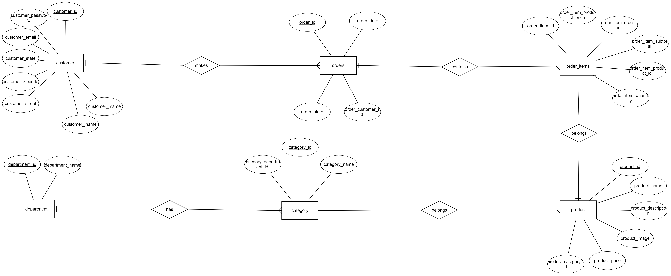
Entity Relationship Diagram

Slide 5
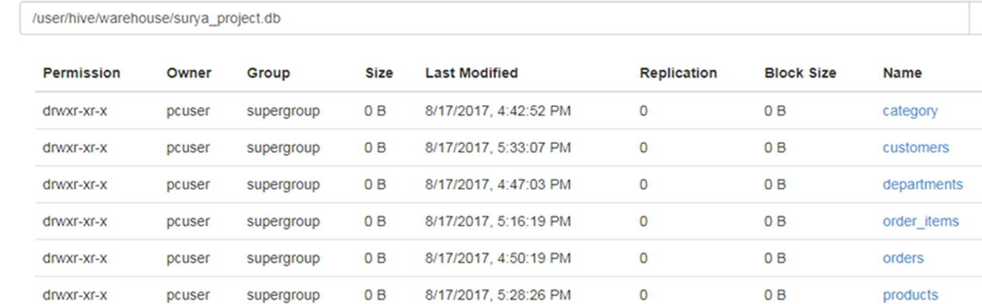
Retails table
Creating tables in mysql.
Importing mysql database in hive(sqoop).
Creating tables in hbase through hive.
Creating tables in spark(zeppelin) and accessing these tables from sql interpreter.

Slide 6
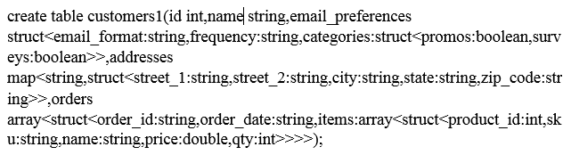
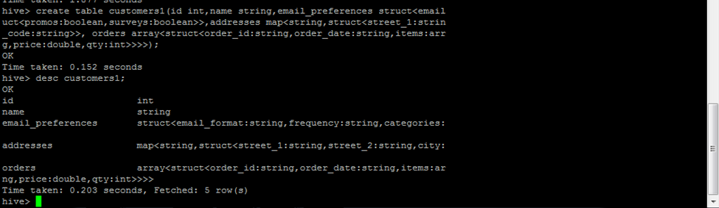
Complex data type customers table

Slide 7
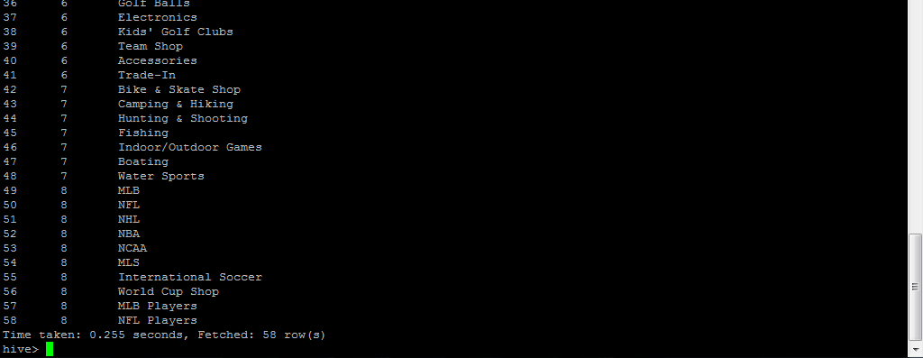
Data ingestion using sqoop
sqoop bin$>sqoop import --connect jdbc:mysql://localhost/surya_project --username root --password root --table category --hive-import --hive-table surya_project.category -m 1;

Slide 8
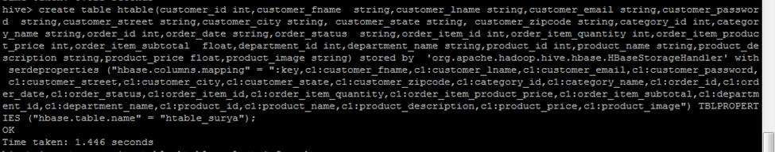
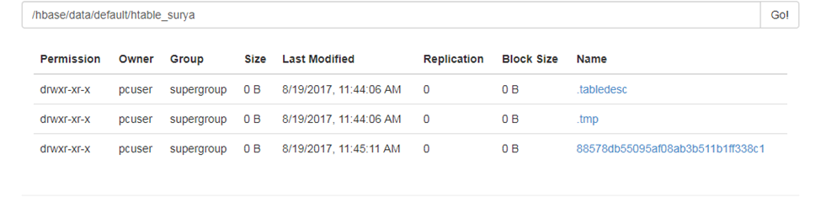
Creating a hbase table through hive

Slide 9
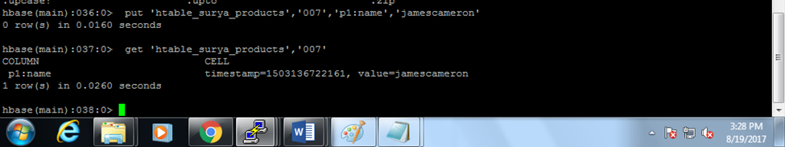
Hbase dml operations
hbase>put 'htable_surya_products','007','p1:name','james cameron’

Slide 10
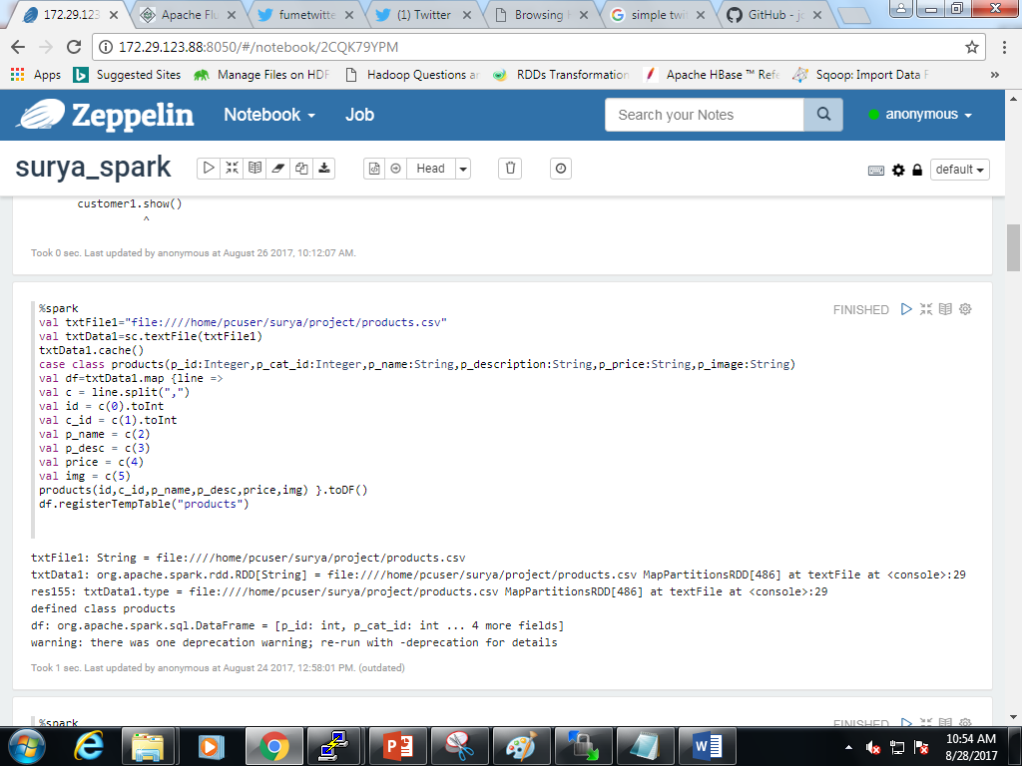
zeppelin
Creating the retailers tables in spark.

Slide 11
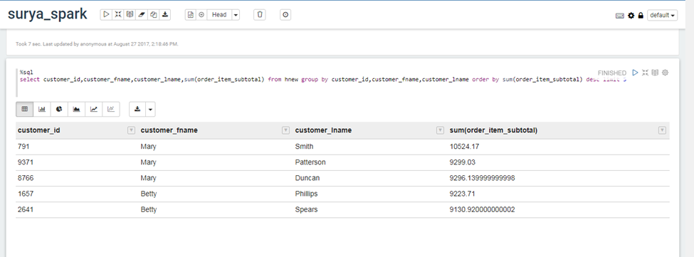
Top 5 customers
BASED ON ORDER ITEM SUBTOTAL:

Slide 12
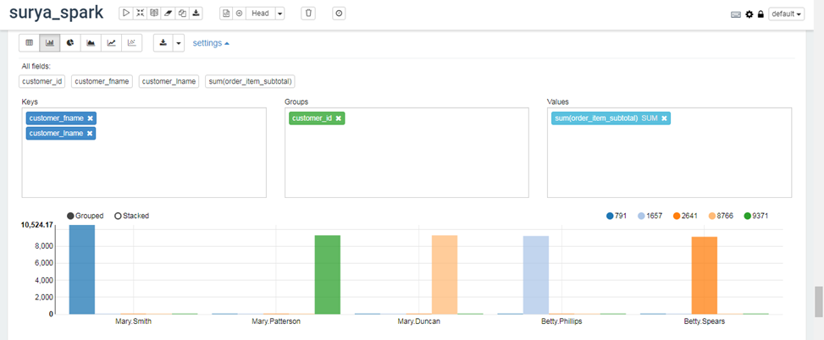
Top 5 customers
BAR GRAPH:

Slide 13
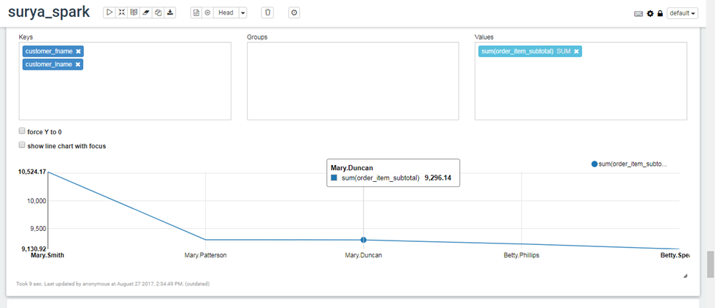
Top 5 customers
LINE CHART:

Slide 14
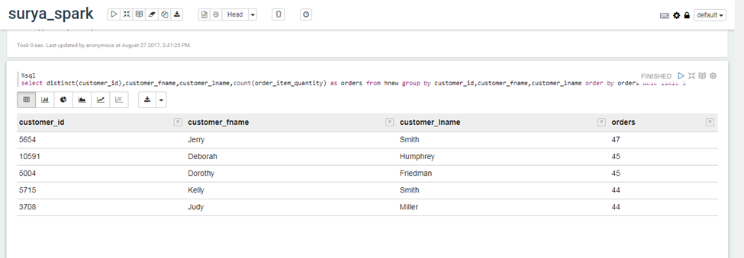
Top 5 customers
BASED ON NUMBER OF ORDERS:

Slide 15
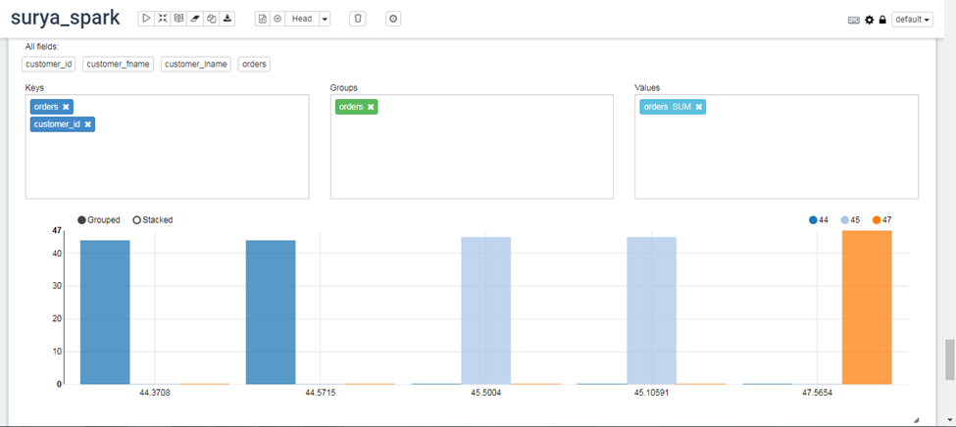
Top 5 customers
BAR GRAPH:

Slide 16
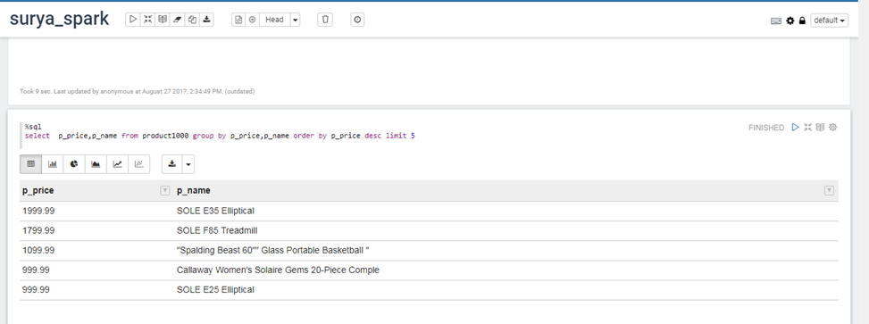
Top 5 products
BASED ON COST PRICE:

Slide 17
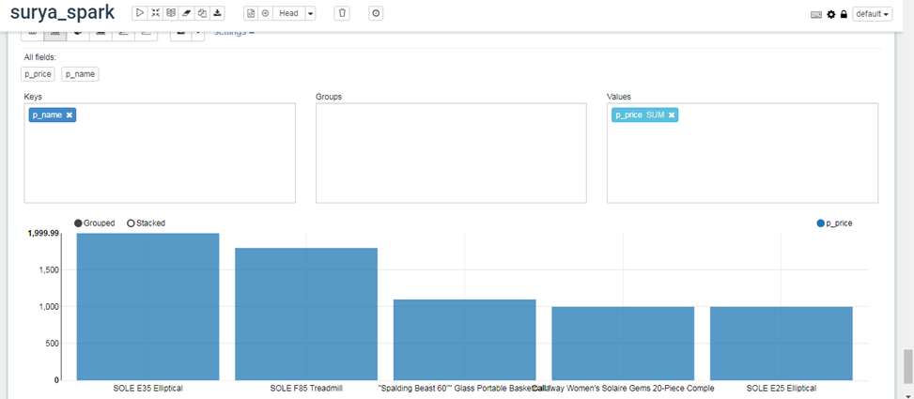
Top 5 products
BAR GRAPH:

Slide 18
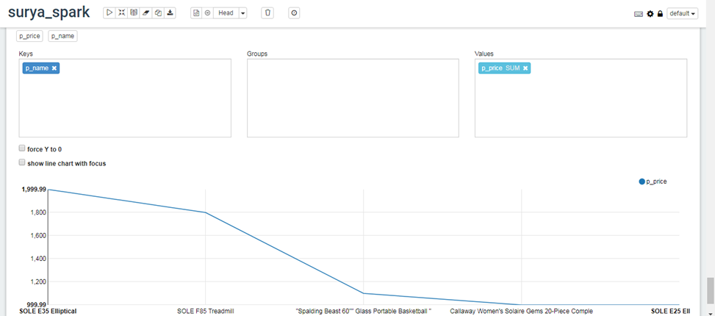
Top 5 products
LINE CHART:

Slide 19
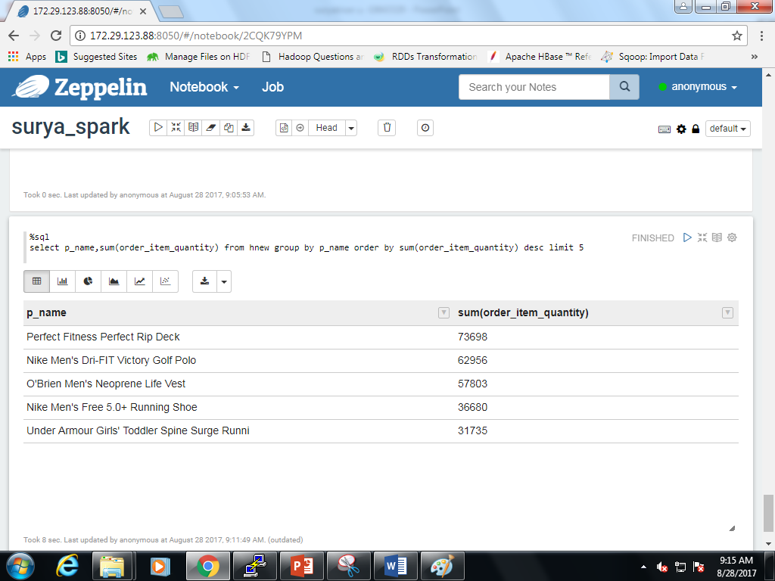
Top 5 orders
Based on order item quantity:

Slide 20
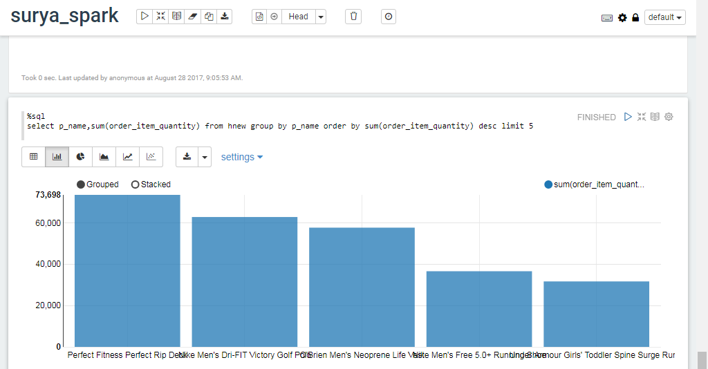
Top 5 orders
Bar graph:

Slide 21
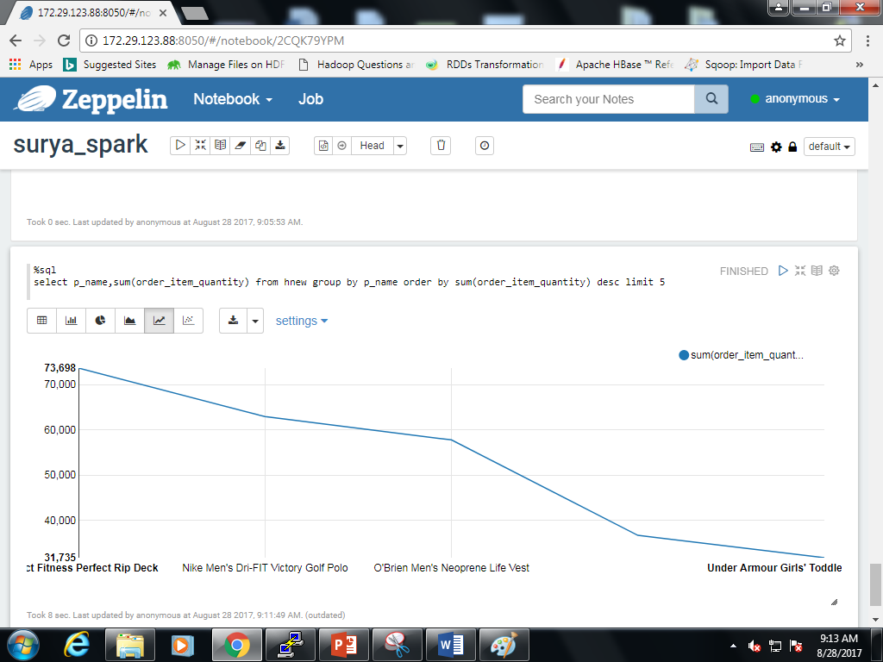
Top 5 orders
Line chart:

Slide 22
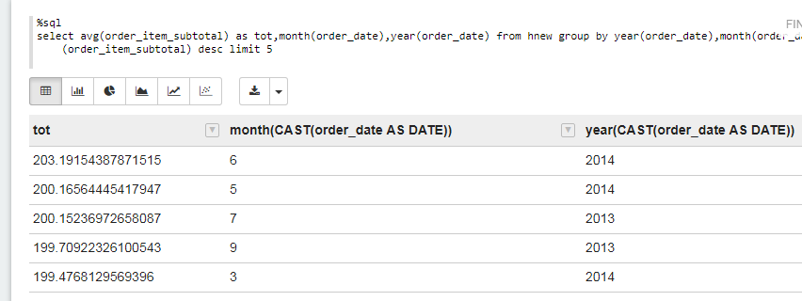
Average sales of particular month(top 5)
%sql select avg ( order_item_subtotal ) as tot, month (order_date ),year(order_date) from hnew group by year( order_date),month( order_date) order by avg(order_item_subtotal) desc limit 5

Slide 23
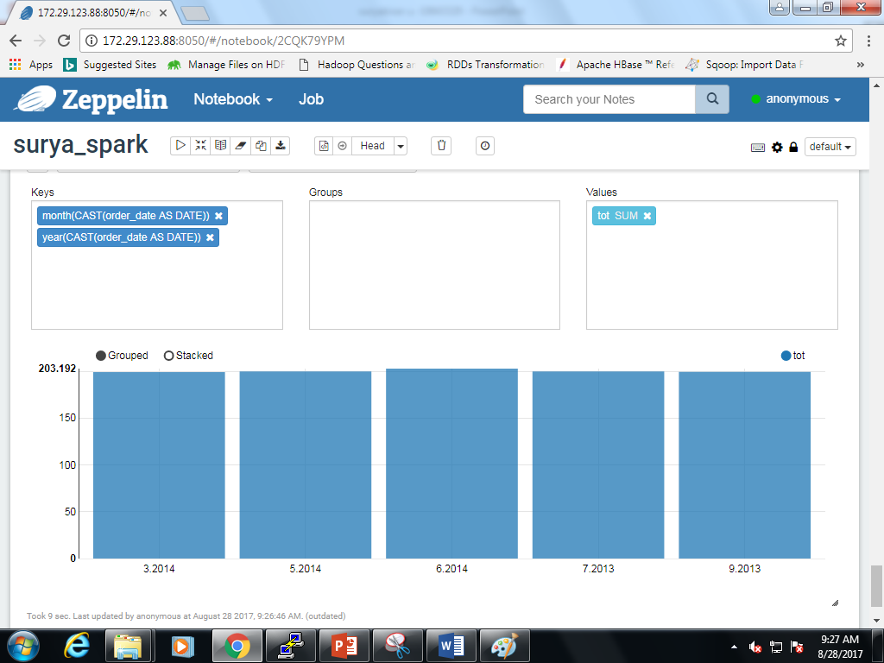
Average sales of particular month(top 5)
Bar chart:

Slide 24
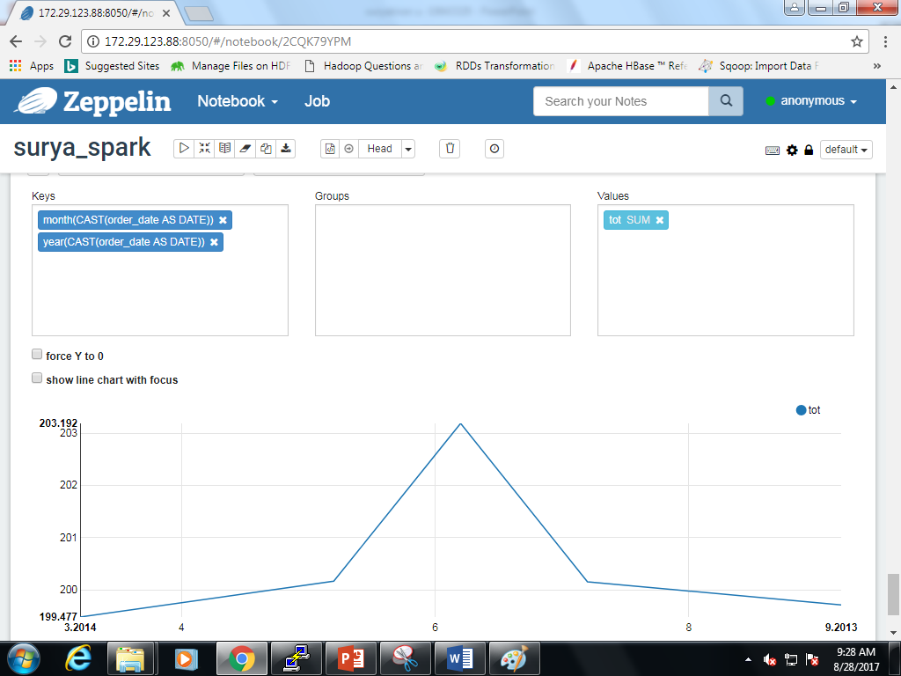
Average sales of particular month(top 5)
Line chart:

Slide 25
Simple spark streaming example
Spark-shell
import org.apache.spark.streaming._
import org.apache.spark.streaming.StreamingContext._
val conf = new SparkConf().setMaster("local[2]").setAppName("NetworkWordCount")
val ssc = new StreamingContext( conf, Seconds(10)) //streaming data duration( rdd distance).
val lines = ssc.socketTextStream("localhost", 9980) //my server
val words = lines.flatMap(_.split(" "))
val pairs = words.map(word => (word, 1))
val wordCounts = pairs.reduceByKey(_ + _)
wordCounts.print()
ssc.start()

Slide 26
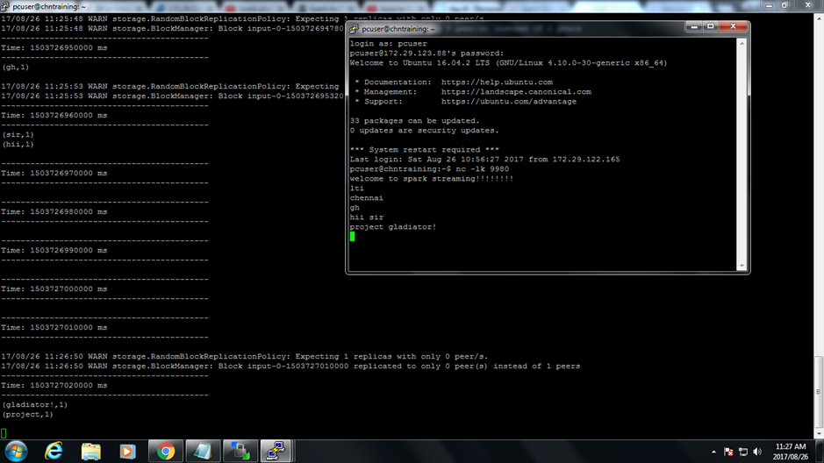
Simple spark streaming example

Slide 27
THANK YOU

